Slide 1
My Classes at Lincoln
By Ryan Collins

Slide 2
Math
I am in algebra 1 and we learn a lot about algebra. It is fun sometimes because we all joke around after our work is done. One of the subjects we have done was one and two step equations. Math is favorite subject so I like that class.

Slide 3
Science
Science is cool
Science is with Mrs.Hodge and we just finished unit 1 about mainly atoms.

Slide 4
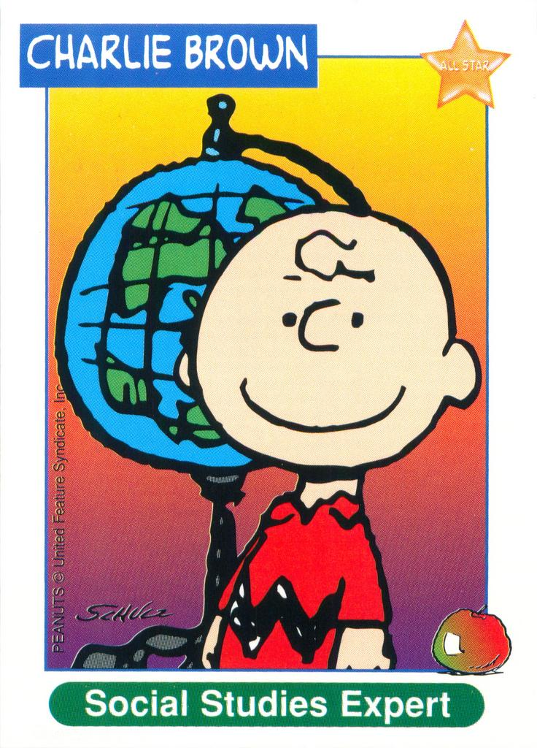
Social Studies
I learn about U.S history.
Go! History
We just learned about the French and Indian War.

Slide 5
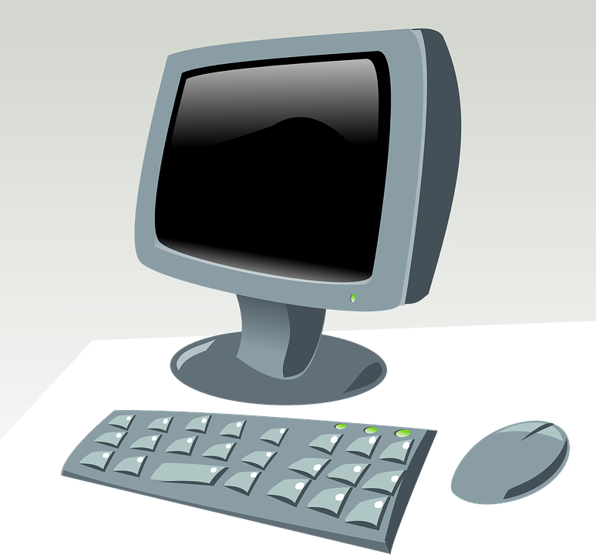
Tech Class
I like tech class I get to learn how to use a computer better. And make cool projects.

